Slide 1
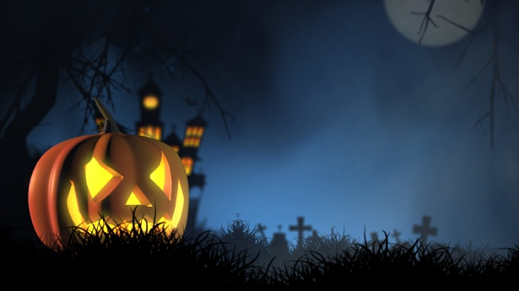
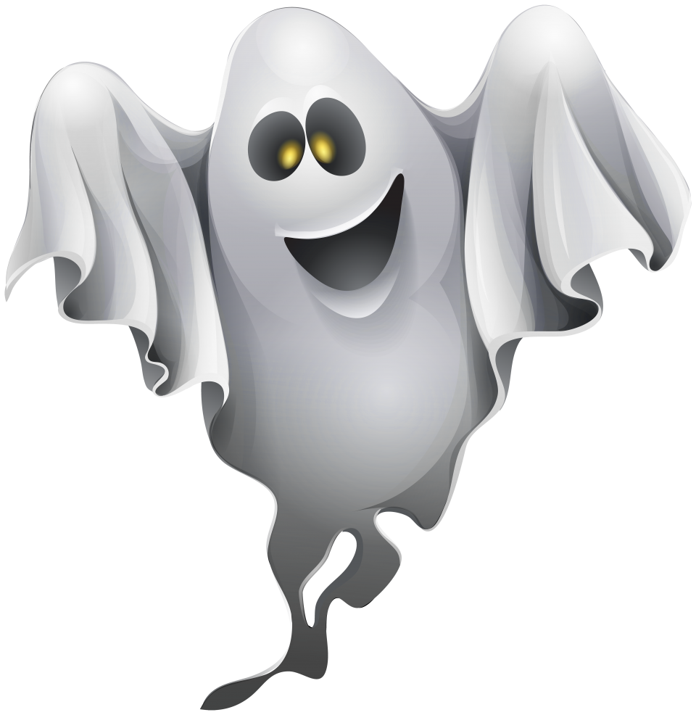

HOLIDAYS;
Halloween

Slide 2

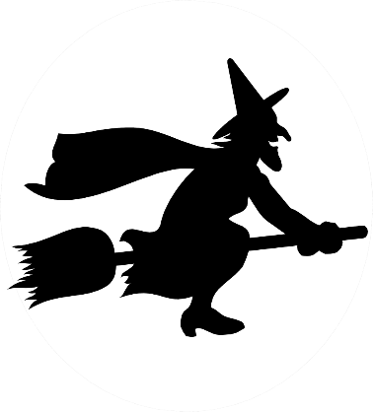

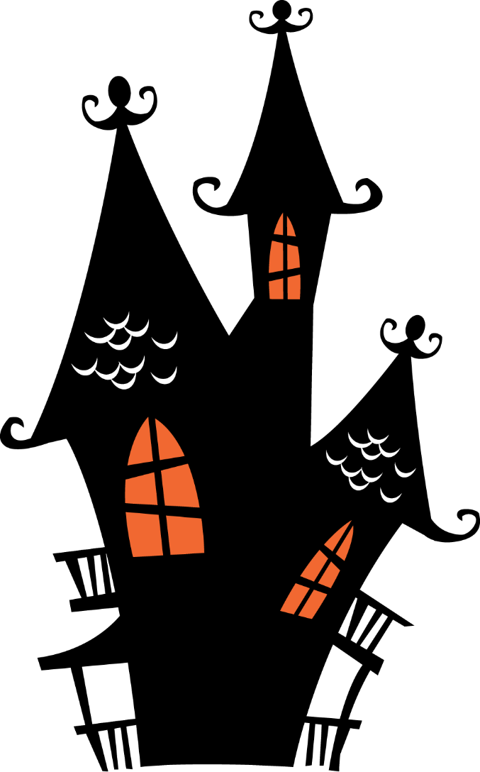



bat
ghost
cat
HALLOWEEN
When do we celebrate Halloween?
Which Halloween traditions do you know?

Slide 3
Try to guess the words. Pokušaj odgonetni riječ vezanu za Halloween.
1 a red fruit that is good for your teeth
2 clothes you wear when you want to look like someone else
3 chocolate, cakes, biscuits are…
4 a big round orange vegetable
AN APPLE
A COSTUME
SWEETS
A PUMPKIN
How much do you know about Halloween
https://wordwall.net/resource/5766162

Slide 4
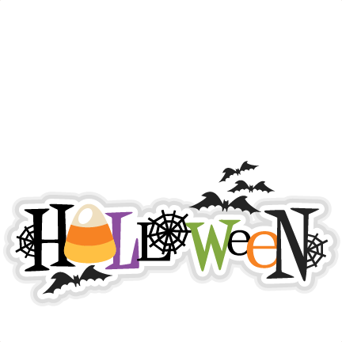
Halloween is an autumn holiday for children. It means “holy evening”, and in the UK and America, they celebrate it on the last day of October, the evening before All Saints’ Day.
Legend says that the veil between our world and the spirit world is the thinnest on Halloween and that the ghosts of the deceased can mingle with the living.
Children often dress up as witches, vampires, ghosts, mummies and other scary creatures. In their costumes, they go from house to house - trick-or-treating. They knock on the door and say “Trick or treat?”. That treat is usually a candy. If the person who answers the door doesn't give children the treat, they play a trick on that person.
On Halloween, children cut faces in the large orange pumpkins and put lights or candles inside. These pumpkins are called “jack-o’-lanterns”, which means “Jack of the lantern”.
Children also play their favourite Halloween game – Bobbing for apples. They fill a tub or a large basin with water and put apples in the water. Apples float on the surface and children try to catch the apple with their teeth.
In America, it is quite popular to have a Halloween costume party. Teenagers watch horror movies, listen to music or tell each other ghost stories. Visiting haunted houses is also popular on Halloween.

Slide 5

Are these statements TRUE or FALSE?
Halloween is a winter holiday for children.
Halloween is celebrated on the 30th of October.
Children dress up as witches, vampires, ghosts, mummies and other scary creatures.
They go trick-or-treating.
On Halloween, children cut faces in the large green watermelons.
Children also play bobbing for carrots.
Halloween is an autumn holiday for children.
Halloween is celebrated on the 31st of October.
On Halloween, children cut faces in the large orange pumpkins.
Children also play bobbing for apples.

Slide 6
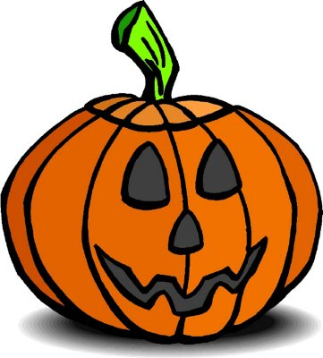
Play and learn: https://wordwall.net/resource/5771159
Legend about Jack
https://youtu.be/MDVFJwHIK5o

Slide 7
Napiši kratku činkvinu (pjesmu u 5 stihova). Pravila su jednostavna!
Line 1 - one word, also the title | jedna riječ, naslov
Line 2 - two adjectives that describe the word in line one | dva pridjeva koji opisuju naslov/temu
Line 3 - three words that give more information about the subject. | tri riječi koje daju više informacija o temi
Line 4 - four words that show emotion about the subject or individual words or a phrase | četiri riječi koje izriču osjećaje uz temu, ili fraza
Line 5 - synonym of the title or a word very similar to it | istoznačnica naslova

Slide 8
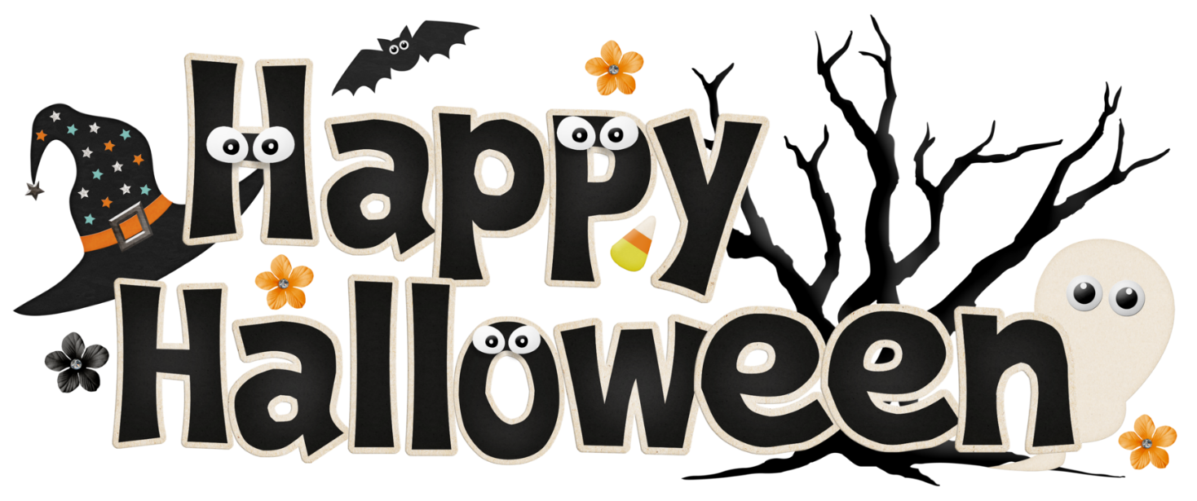
Halloween
Scary, spooky
Holiday for children
Jack-o’-lantern pumpkin
Happy Halloween!

